Slide 1
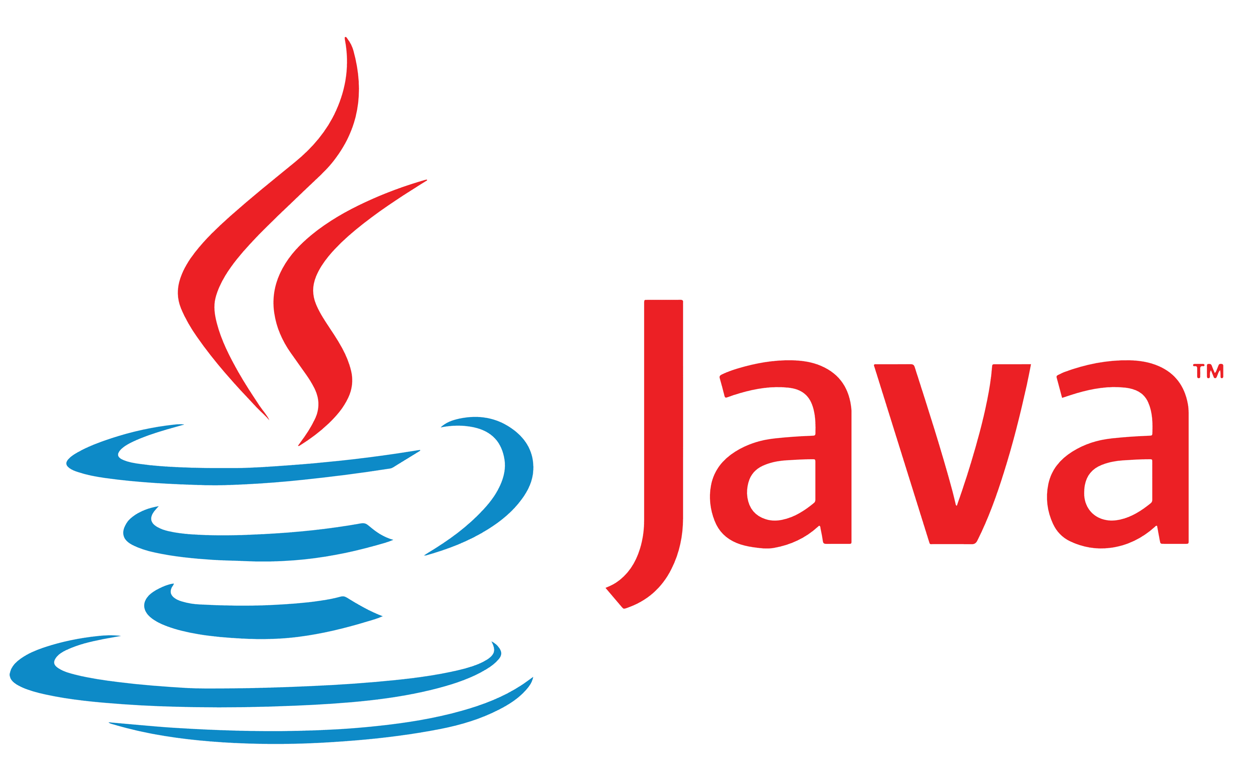
Introduction

Slide 2
History of Java
Java was originally developed by Sun Microsystems starting in 1991
James Gosling
Patrick Naughton
Chris Warth
Ed Frank
Mike Sheridan
This language was initially called Oak
Renamed Java in 1995

Slide 3
What is Java
A simple, object‐oriented, distributed, interpreted, robust, secure, architecture neutral, portable, high‐performance, multithreaded, and dynamic language ‐‐ Sun Microsystems
Object‐Oriented
No free functions
All code belong to some class
Classes are in turn arranged in a hierarchy or package structure

Slide 4
What is Java
Distributed
Fully supports IPv4, with structures to support IPv6
Includes support for Applets: small programs embedded in HTML documents
Interpreted
The program are compiled into Java Virtual Machine (JVM) code called bytecode
Each bytecode instruction is translated into machine code at the time of execution

Slide 5
What is Java
Robust
Java is simple – no pointers/stack concerns
Exception handling – try/catch/finally series allows for simplified error recovery
Strongly typed language – many errors caught during compilation

Slide 6
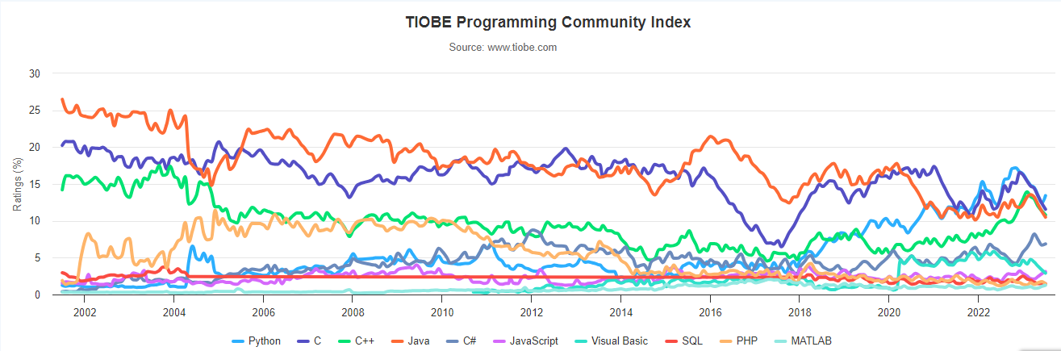
Java in TIOBE Programming Index
https://www.tiobe.com/tiobe-index/

Slide 7
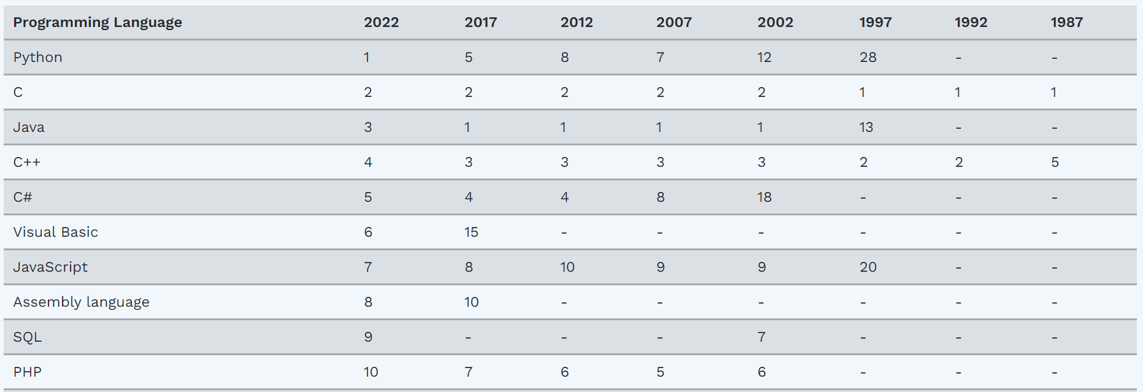
Java – The Most Popular (2002-2020)

Slide 8
Java Editions
Java 2 Platform, Standard Edition (J2SE)
Used for developing desktop-based applications and networking applications
Java 2 Platform, Enterprise Edition (J2EE)
Used for developing large‐scale, distributed networking applications and web‐based applications
Java 2 Platform, Micro Edition (J2ME)
Used for developing applications for small memory‐constrained devices, such as cell phones, pagers and PDAs

Slide 9
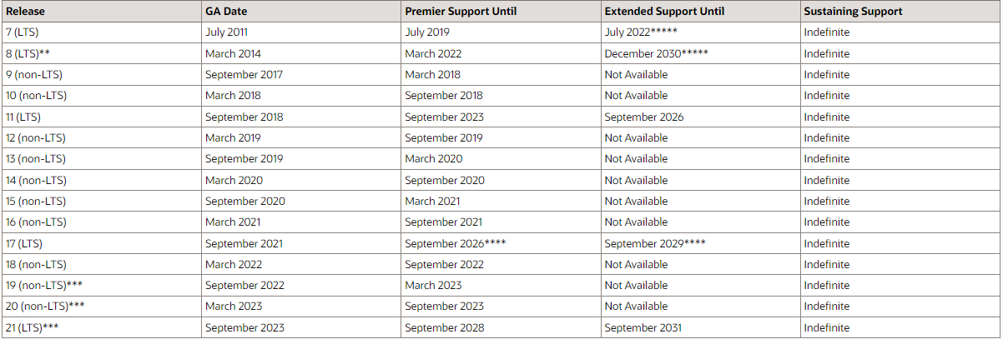
Java SE Versions

Slide 10




Java platform
public class HelloWorld
{
public static void main( String [] args )
{
System.out.println(“hello”);
}
}
Java Program ( Class File )
Java Platform
HelloWorld.java
Windows NT
Java API
Compile
javac
Java
Interpreter
Java Virtual Machine
Hardware-Based Platform
2387D47803 A96C16A484 54B646F541
06515EE464
Java Bytecode
Java
Interpreter
HelloWorld.class
Power Macintosh

Slide 11
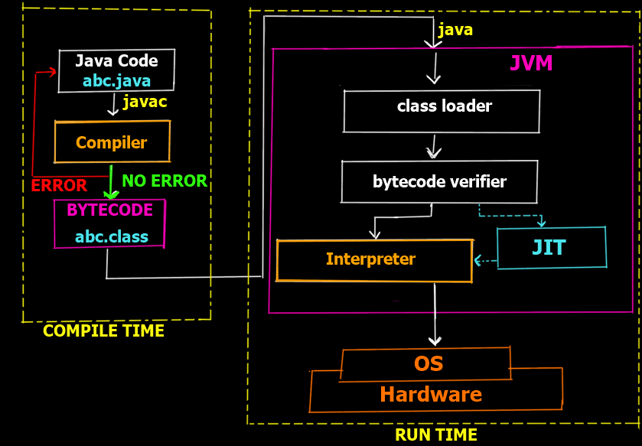
Java Development Environment
Edit
Create/edit the source code
Compile
Compile the source code
Load
Load the compiled code
Verify
Check against security restrictions
Execute
Execute the compiled

Slide 12
Phase 1: Creating a Program
Any text editor or Java IDE (Integrated Development Environment) can be used to develop Java programs
Java source‐code file names must end with the .java extension
Some popular Java IDEs are
IntelliJ
VS Code (with appropriate extensions)
NetBeans
Eclipse

Slide 13
Phase 2: Compiling a Java Program
javac Welcome.java
Searches the file in the current directory
Compiles the source file
Transforms the Java source code into bytecodes
Places the bytecodes in a file named Welcome.class

Slide 14
Bytecodes *
They are not machine language binary code
They are independent of any particular microprocessor or hardware platform
They are platform‐independent instructions
Another entity (interpreter) is required to convert the bytecodes into machine codes that the underlying microprocessor understands
This is the job of the JVM (Java Virtual Machine)

Slide 15
JVM (Java Virtual Machine) *
It is a part of the JDK and the foundation of the Java platform
It can be installed separately or with JDK
A virtual machine (VM) is a software application that simulates a computer, but hides the underlying operating system and hardware from the programs that interact with the VM
It is the JVM that makes Java a portable language

Slide 16
JVM (Java Virtual Machine) *
The same bytecodes can be executed on any platform containing a compatible JVM
The JVM is invoked by the java command
java Welcome
It searches the class Welcome in the current directory and executes the main method of class Welcome
It issues an error if it cannot find the class Welcome or if class Welcome does not contain a method called main with proper signature

Slide 17
Phase 3: Loading a Program *
One of the components of the JVM is the class loader
The class loader takes the .class files containing the programs bytecodes and transfers them to RAM
The class loader also loads any of the .class files provided by Java that our program uses

Slide 18
Phase 4: Bytecode Verification *
Another component of the JVM is the bytecode verifier
Its job is to ensure that bytecodes are valid and do not violate Java’s security restrictions
This feature helps to prevent Java programs arriving over the network from damaging our system

Slide 19
Phase 5: Execution
Now the actual execution of the program begins
Bytecodes are converted to machine language suitable for the underlying OS and hardware
Java programs go through two compilation phases
Source code ‐> Bytecodes
Bytecodes ‐> Machine language

Slide 20
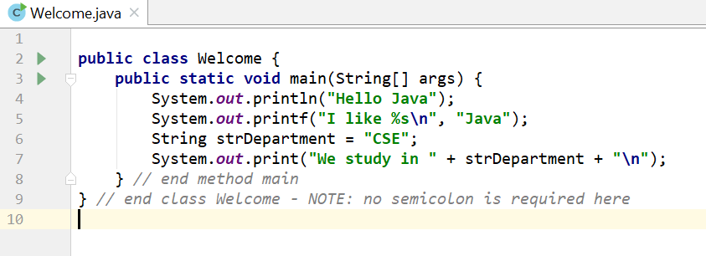
Editing a Java Program

Slide 21
Examining Welcome.java
A Java source file can contain multiple classes, but only one class can be a public class
Typically, Java classes are grouped into packages (similar to namespaces in C++)
A public class is accessible across packages
The source file name must match the name of the public class defined in the file with the .java extension

Slide 22
Examining Welcome.java
In Java, there is no provision to declare a class, and then define the member functions outside the class
Body of every member function of a class (called method in Java) must be written when the method is declared
Java methods can be written in any order in the source file
A method defined earlier in the source file can call a method defined later

Slide 23
Examining Welcome.java
public static void main(String[] args)
main is the starting point of every Java application
public is used to make the method accessible by all
static is used to make main a static method of class Welcome. Static methods can be called without using any object; just using the class name. JVM call main using the ClassName.methodName (Welcome.main) notation
void means main does not return anything
String args[ ] represents an array of String objects that holds the command line arguments passed to the application. Where is the length of args array?

Slide 24
Examining Welcome.java
Think of JVM as a outside Java entity who tries to access the main method of class Welcome
main must be declared as a public member of class Welcome
JVM wants to access main without creating an object of class Welcome
main must be declared as static
JVM wants to pass an array of String objects containing the command line arguments
main must take an array of String as parameter

Slide 25
Examining Welcome.java
System.out.println()
Used to print a line of text followed by a new line
System is a class inside the Java API
out is a public static member of class System
out is an object of another class of the Java API
out represents the standard output (similar to stdout or cout)
println is a public method of the class of which out is an object

Slide 26
Examining Welcome.java
System.out.print() is similar to System.out.println(), but does not print a new line automatically
System.out.printf() is used to print formatted output like printf() in C
In Java, characters enclosed by double quotes ("") represents a String object, where String is a class of the Java API
We can use the plus operator (+) to concatenate multiple String objects and create a new String object

Slide 27
Compiling a Java Program
Place the .java file in the bin directory of your Java installation
C:\Program Files\Java\jdk-17.0.4\bin
Open a command prompt window and go to the bin directory
Execute the following command
javac Welcome.java
If the source code is ok, then javac (the Java compiler) will produce a file called Welcome.class in the current directory

Slide 28
Compiling a Java Program
If the source file contains multiple classes then javac will produce separate .class files for each class
Every compiled class in Java will have their own .class file
.class files contain the bytecodes of each class
So, a .class file in Java contains the bytecodes of a single class only

Slide 29
Executing a Java Program
After successful compilation execute the following command
java Welcome
Note that we have omitted the .class extension here
The JVM will look for the class file Welcome.class and search for a public static void main(String args[ ]) method inside the class
If the JVM finds the above two, it will execute the body of the main method, otherwise it will generate an error and will exit immediately

Slide 30
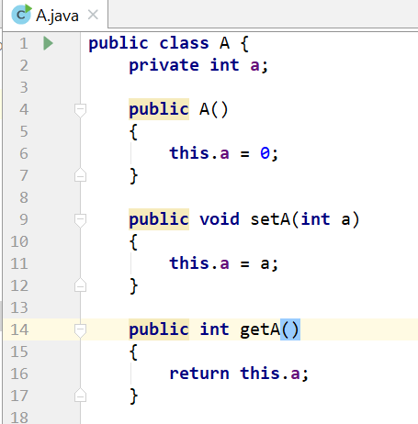
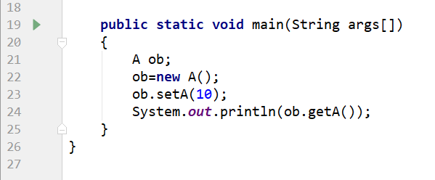
Another Java Program

Slide 31

Examining A.java
The variable of a class type is called a reference
ob is a reference to A object
Declaring a class reference is not enough, we have to use new to create an object
Every Java object has to be instantiated using keyword new
We access a public member of a class using the dot operator (.)
Dot (.) is the only member access operator in Java
Java does not have ->, & and *

Slide 32
Primitive (built‐in) Data types
Integers
byte 8‐bit integer (new)
short 16‐bit integer
int 32‐bit signed integer
long 64‐bit signed integer
Real Numbers
float 32‐bit floating‐point number
double 64‐bit floating‐point number
Other types
char 16‐bit, Unicode 2.1 character
boolean true or false, false is not 0 in Java

Slide 33
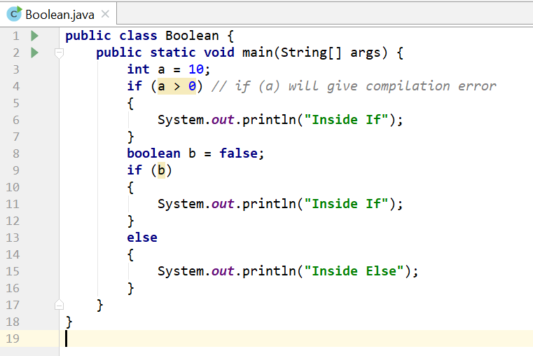
Boolean Type

Slide 34
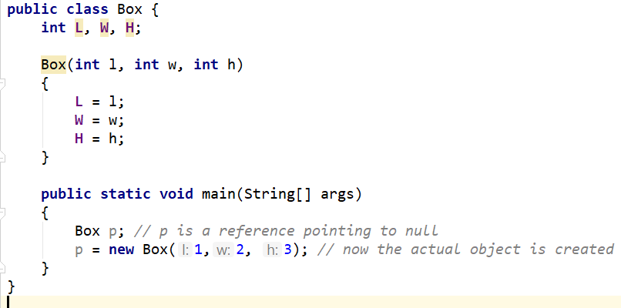
Non‐primitive Data types
The non‐primitive data types in java are
Objects
Array
Non‐primitive types are also called reference types

Slide 35
Primitive vs. Non‐primitive type
Primitive types are handled by value – the actual primitive values are stored in variable and passed to methods
int x = 10;
public MyPrimitive(int x) { }
Non‐primitive data types (objects and arrays) are handled by reference – the reference is stored in variable and passed to methods
Box b = new Box(1,2,3);
public MyNonPrimitive(Box x) { }

Slide 36
Primitive vs. Non‐primitive type
Primitive types are handled by value
There is no easy way to swap two primitive integers in Java
No method like void swap(int *x, int *y)
Can only be done using object or array
But do we actually need a method to swap?
x += (y - (y = x)) does the same in a single statement

Slide 37
Java References
Java references are used to point to Java objects created by new
Java objects are always passed by reference to other functions, never by value
Java references act as pointers but does not allow pointer arithmetic
We cannot read the value of a reference and hence cannot find the address of a Java object
We cannot take the address of a Java reference

Slide 38
Java References
We can make a Java reference point to a new object
By copying one reference to another
ClassName ref2 = ref1; // Here ref1 is declared earlier
By creating a new object and assign it to the reference ClassName ref1 = new ClassName();
We cannot place arbitrary values to a reference except the special value null which means that the reference is pointing to nothing
ClassName ref1 = 100; // compiler error
ClassName ref2 = null; // no problem

Slide 39
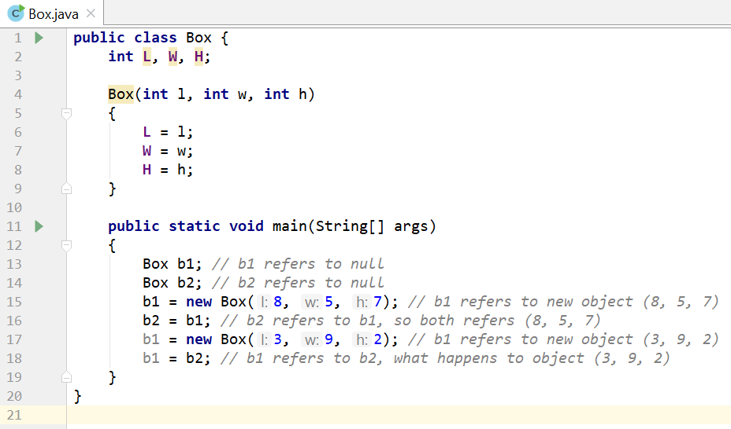
Java References

Slide 40
Java Textbook
Java: The Complete Reference, 12th Edition by Herbert Schildt
Effective Java, 3rd edition by Joshua Bloch (for future)

